Slide 1





HackOrbit 2025
AGRIAR

Slide 2

THEME & PROBLEM STATEMENT
THEME: Sustainability
PROBLEM STATEMENT: INEFFICIENT & REACTIVE AGRICULTURE PRACTICES LEADING TO SUBOPTIMAL YIELDS AND RESOURCE WASTE

Slide 3
PROPOSED SOLUTION
AI-POWERED SOIL ANALYSIS
Early Disease Detection
Smart Crop Recommendations
Personalized Farmer Insights
Integrated & Accessible Platform

Slide 4
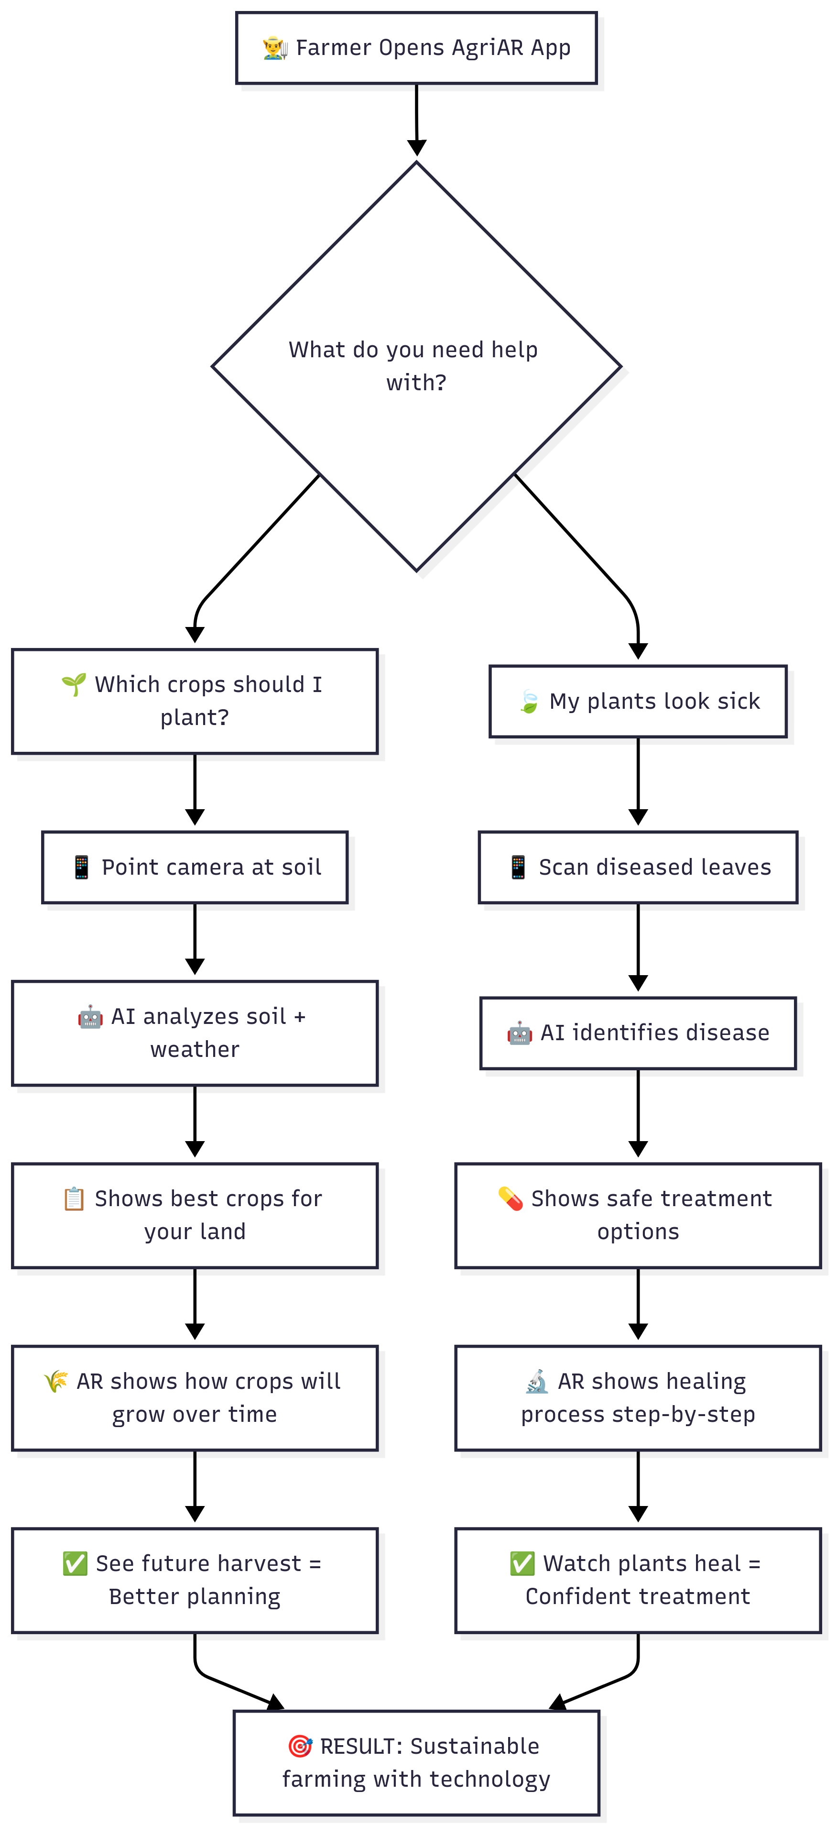
FLOWCHART:

Slide 5
FLOWCHART / DIAGRAM
Farmers open mobile app and select between crop planning or disease diagnosis.
Computer vision analyzes soil images combined with GPS and weather data.
AI recommends optimal crops with yield predictions based on local conditions.
AR displays time-lapse visualization of crop growth over entire season.
CNN models identify plant diseases from leaf scans with high accuracy.
System provides eco-friendly treatment options from curated pesticide database.
AR shows step-by-step healing process to build farmer confidence.
Data-driven recommendations replace traditional guesswork in farming decisions.
Measurable outcomes include increased yields and reduced chemical usage..

Slide 6
FEATURES AND NOVELTY:
AI-Powered Soil Analysis: Accurately determines soil texture and predicts fertility levels from uploaded images.
Early Disease Detection: Identifies plant diseases from leaf images, providing diagnosis, severity assessment, and treatment recommendations.
Smart Crop Recommendations: Suggests optimal crops based on soil analysis results, location, and seasonal data for maximized yield.
Personalized Farmer Insights: Provides farmers with a historical record of their soil analyses, disease detections, and crop recommendations.
Augmented Reality (AR) Integration: Conceptually includes AR capabilities for visualizing plant growth, disease progression/treatment, and potentially other agricultural data directly in the field (requires a mobile app).

Slide 7
DRAWBACK AND SHOWSTOPPERS
Reliance on Data Quality and Quantity
Environmental Variability & Generalization
Internet Connectivity Requirement (for Web Version)
Hardware Limitations for AR
Scalability for Production Use

Slide 8
AGRIAR
Name of team members and their contact details
NAME: GOWTHAMI BOLLENI
MAIL ID: gowthamibolleni05@gmail.com

Slide 9
Thank you

